Slide 1

UNIVERSITY INSTITUTE OF ENGINEERING
DEPARTMENT OF AIT - CSE
Bachelor of Engineering (CSE)
Advanced Programming (20CST-337)
By: Rahul Rathore(E12904)
Lecture -3
Computational Mathematics
DISCOVER . LEARN . EMPOWER

Slide 2
Chapter | Course Objectives
1. | This subject aims to focuses on Advanced concept of C++ and advanced data structure to students. It focuses on advanced level analysis of algorithm and computational mathematics.
Chapter | Course Outcomes
1. | Explain the data structure and OOPS concepts using C++. Apply the shortest path and minimum spanning algorithms in computer networks. Examine the complexity of searching and sorting algorithms, and optimization through arrays, linked structures, stacks, queues, trees, and graphs. Decide and implement an appropriate graph algorithm and hashing function in computer networks for data security. Construct security encryption and decryption algorithms using computational mathematics and graph algorithm.

Slide 3
Contents
Modular inverse
linear congruence equation
Chinese Reminder theorem

Slide 4
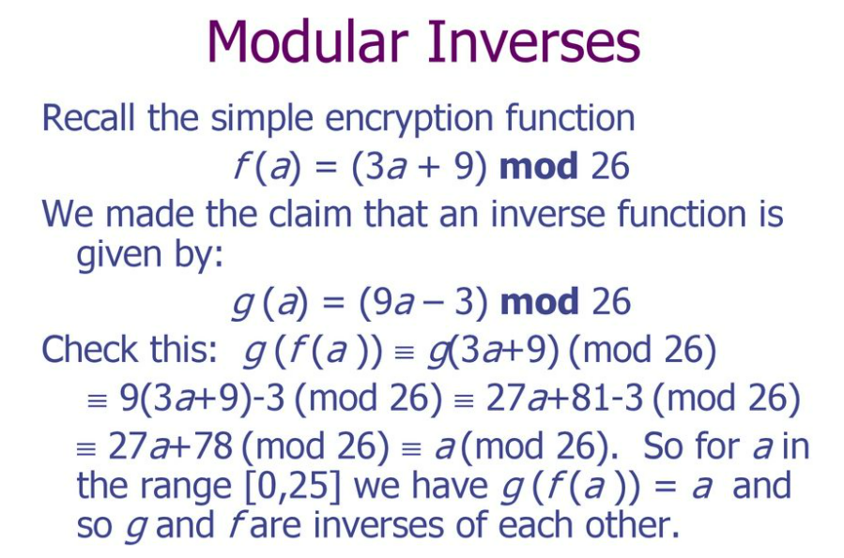
Modular inverse

Slide 5
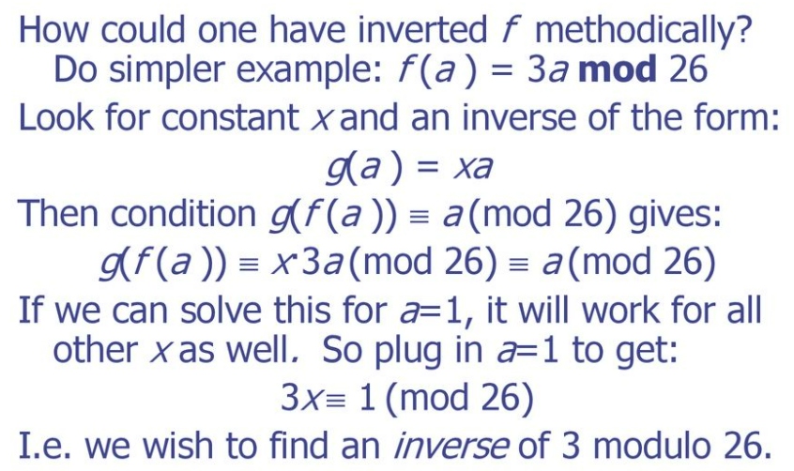
Modular inverse

Slide 6
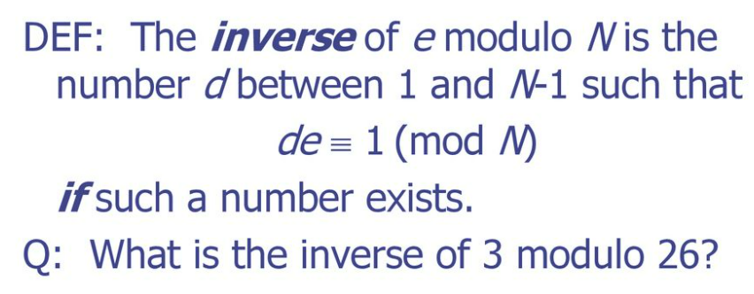
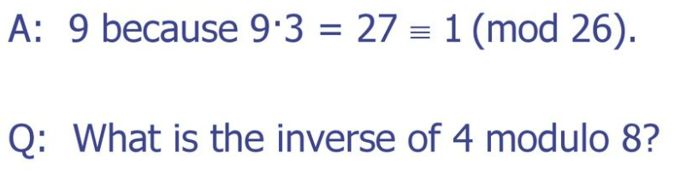
Modular inverse

Slide 7
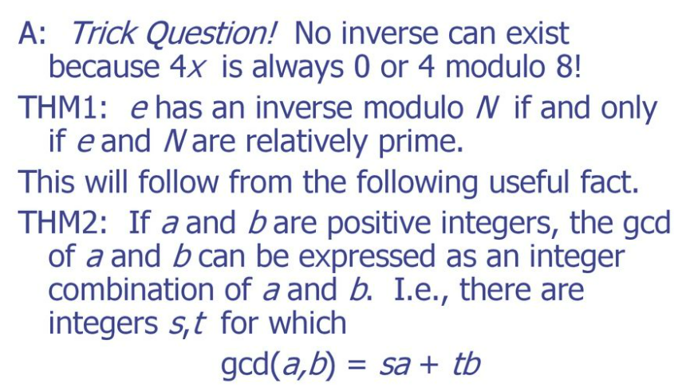
Modular inverse

Slide 8
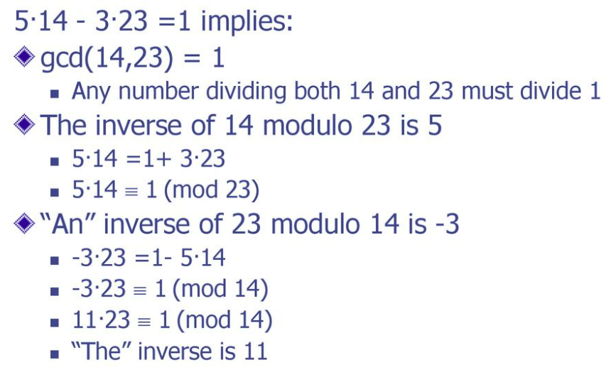
Modular inverse

Slide 9
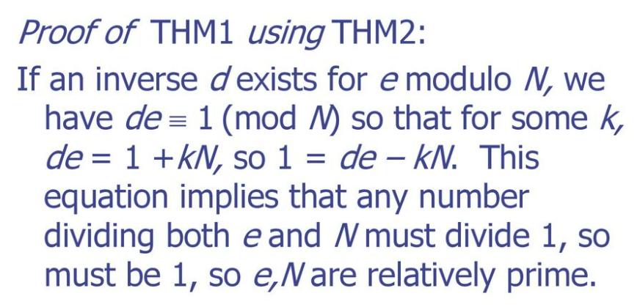
Modular inverse

Slide 10
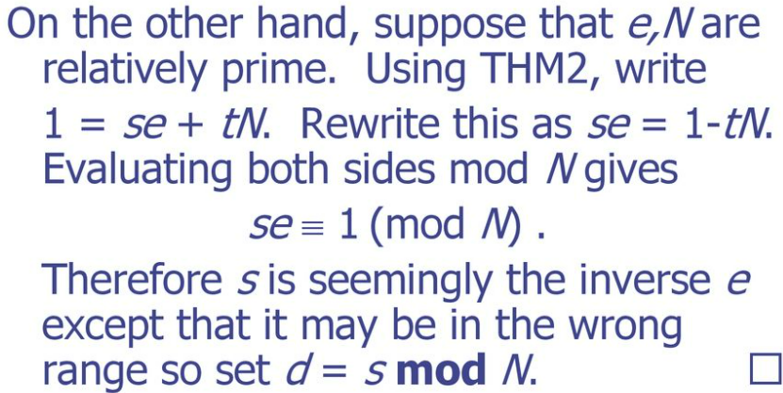
Modular inverse

Slide 11
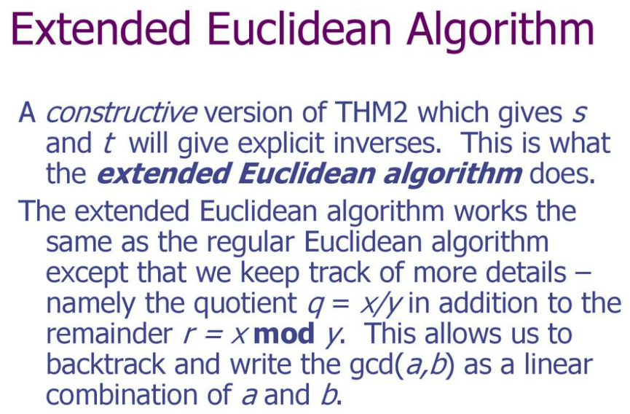
Modular inverse

Slide 12
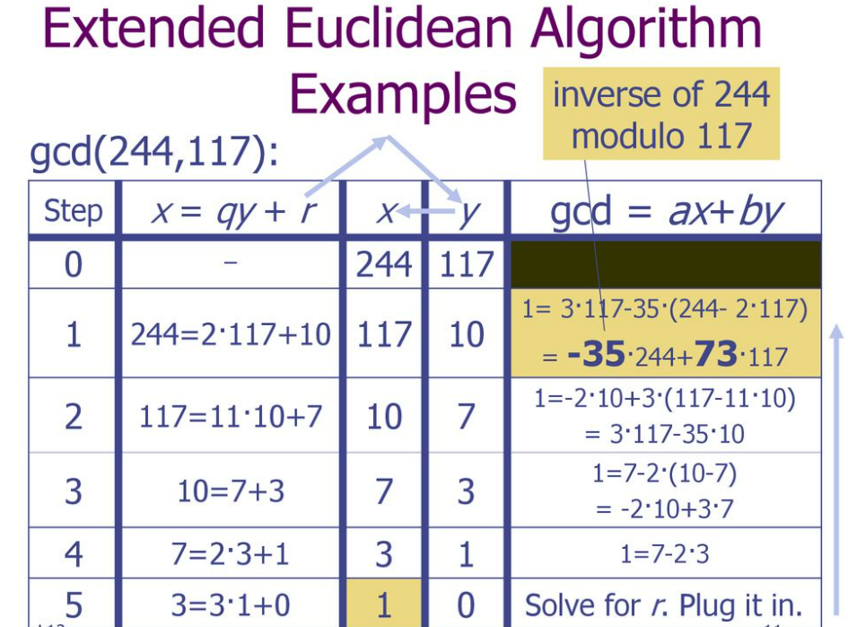
Modular inverse

Slide 13
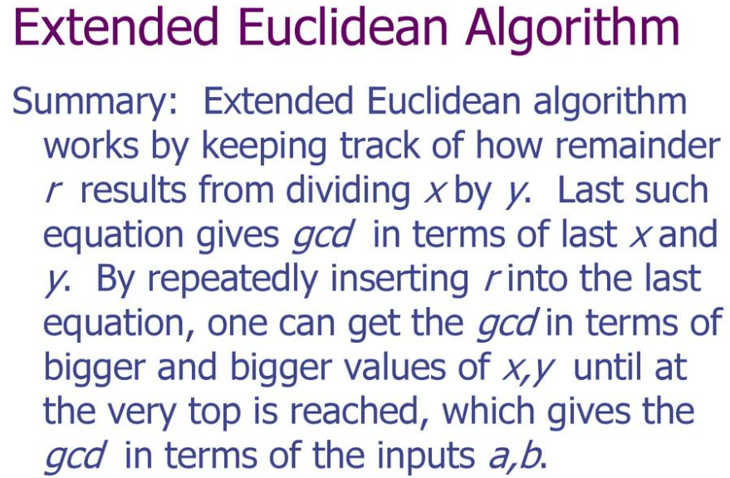
Modular inverse

Slide 14

Solving congruences
Definition: A congruence of the form ax ≡ b (mod m) where m is a positive integer, a and b are integers and x is a variable is called a linear congruence.
Goal: Find all integers x that satisfy this congruence.
Example: What are all of the times that are “congruent to” 2 o’clock?
⇒ Want x ≡ 2 mod 12

Slide 15
Solving congruences
Linear congruence: ax ≡ b (mod m)
This is analogous to the linear equation: ax = b
One way to solve this simple equation is to multiply both sides by 1/a: x = b/a
Here, we use the fact that 1/a is the multiplicative inverse of a
Recall that 1/a is the multiplicative inverse of a because (1/a) a = 1
We’ll use the same strategy to solve the linear congruence.

Slide 16
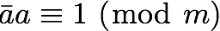
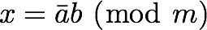
Solving congruences
Linear congruence: ax ≡ b (mod m)
Strategy: Find a number such that
The number is called the inverse of a modulo m
If we know the inverse, then we can find the solution to the linear congruence by

Slide 17
Solving congruences
Example: Solve 3x ≡ 4 (mod 7)

Slide 18
Solving congruences
Example: Solve 3x ≡ 4 (mod 7)
Note that 5·3 = 15 = 2·7 + 1 ≡ 1 (mod 7) ← Note that -2 would also work
So “the” inverse of 3 modulo 7 is 5
Multiplying both sides of the linear congruence by 5 gives x ≡ 5 · 4 (mod 7) ≡ 20 (mod 7) ≡ 6 (mod 7)
So any x that is congruent to 6 mod 7 is a solution. E.g., 6, 13, 20, -1, …
Check: 3 · 6 = 18 = 2·7 + 4 ≡ 4 (mod 7)
Check: 3 · -1 = -3 = -1·7 + 4 ≡ 4 (mod 7)

Slide 19
Solving congruences
Okay! So if we can find the inverse of a (mod m) then we can solve the linear congruence ax ≡ b (mod m)
Important Question #1: Does such an inverse always exist?
Important Question #2: If so, can we find it more systematically? (than our previous method of “thinking really hard”

Slide 20
Solving congruences
Theorem: If a and m are relatively prime, then an inverse of a modulo m exists

Slide 21
Solving congruences
Theorem: If a and m are relatively prime, then an inverse of a modulo m exists
Proof: S’pose a and m are relatively prime.
⇒ gcd(a, m) = 1
⇒ Bezout’s theorem tells us that there exist integers s and t such that sa + tm = 1
⇒ this implies that sa + tm ≡ 1 (mod m)
⇒ but tm ≡ 0 (mod m), so it must be the case that sa ≡ 1 (mod m)
⇒ So s must be the inverse of a (mod m) that we’re after
Note: This proof also shows us how to actually find the inverse…

Slide 22
Solving congruences
The inverse of a is exactly the coefficient s from Bezout’s theorem, and we saw last time how to find such an s
Example: Determine the inverse of 19 modulo 141
Step 1: Do the Euclidean algorithm to confirm that gcd(19,141) = 1

Slide 23
Solving congruences
The inverse of a is exactly the coefficient s from Bezout’s theorem, and we saw last time how to find such an s
Example: Determine the inverse of 19 modulo 141
Step 1: Do the Euclidean algorithm to confirm that gcd(19,141) = 1
141 = 7 · 19 + 8
19 = 2 · 8 + 3
8 = 2 · 3 + 2
3 = 1 · 2 + 1
2 = 2 · 1 + 0
Since the last remainder was 1, the Euclidean algorithm tells us that 19 and 141 are relatively prime, and theorem applies → there is an inverse of 19 (mod 141)

Slide 24
Solving congruences
The inverse of a is exactly the coefficient s from Bezout’s theorem, and we saw last time how to find such an s
Example: Determine the inverse of 19 modulo 141
Step 2: Do the Euclidean algorithm in reverse to find the coefficient on 19
141 = 7 · 19 + 8
19 = 2 · 8 + 3
8 = 2 · 3 + 2
3 = 1 · 2 + 1
2 = 2 · 1 + 0

Slide 25
Solving congruences
The inverse of a is exactly the coefficient s from Bezout’s theorem, and we saw last time how to find such an s
Example: Determine the inverse of 19 modulo 141
Step 2: Do the Euclidean algorithm in reverse to find the coefficient on 19
141 = 7 · 19 + 8
19 = 2 · 8 + 3
8 = 2 · 3 + 2
3 = 1 · 2 + 1
2 = 2 · 1 + 0
⇒ So 52 is the inverse of 19 (mod 141)
1 = 3 - 1·2
= 3 - 1·(8 - 2·3) = 3 - 1·8 + 2·3 = 3·3 - 1·8
= 3·(19 - 2·8) - 1·8 = 3·19 - 6·8 - 1·8 = 3·19 - 7·8
= 3·19 - 7·(141 - 7·19) = 3·19 - 7·141 + 49·19
= 52·19 - 7·141

Slide 26
Solving congruences
Example: Solve the linear congruence 19x ≡ 4 (mod 141)

Slide 27
Solving congruences
Example: Solve the linear congruence 19x ≡ 4 (mod 141)
Solution: Multiplying both sides of the congruence by 52 (the inverse of 19 modulo 141) gives:
x ≡ 52 · 4 (mod 141)
≡ 208 (mod 141)
≡ 67 (mod 141)
Check: 19 · 67 = 1273 = 9 · 141 + 4 ≡ 4 (mod 141)
19 · 349 = 6631 = 47 · 141 + 4 ≡ 4 (mod 141)
(349 = 67 + 2·141)

Slide 28
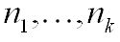
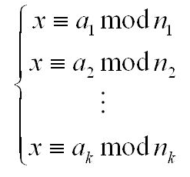
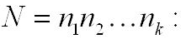
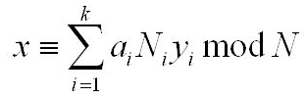
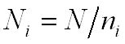
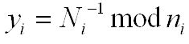
Chinese Reminder theorem
Chinese Remainder Theorem
If integers are pairwise coprime,
Then the system of congruences
has a unique solution modulo
Where and

Slide 29
Chinese Reminder theorem
Chinese Remainder Theorem
Example: Solve the following simultaneous linear congruences?
x ≡ 2 (mod 3)
x ≡ 3 (mod 5)
x ≡ 2 (mod 7)
Solution:
Calculate N = 3 × 5 × 7 = 105
Calculate
N1 = 105 / 3 = 35 ,
N2 = 105 / 5 = 21 ,
N3 = 105 / 7 = 15
Calculate
y1 = 35⁻¹ mod 3 = 2 since 35 × 2 ≡ 1 (mod 3)
y2 = 21⁻¹ mod 5 = 1 since 21 × 1 ≡ 1 (mod 5)
y3 = 15⁻¹ mod 7 = 1 since 15 × 1 ≡ 1 (mod 7)
(4) The solution to the simultaneous equations is
x = 2 × 35 × 2 + 3 × 21 × 1 + 2 × 15 × 1
= 233 (mod 105) ≡ 23 (mod 105)

Slide 30
Chinese Reminder theorem
Determine the number of solutions for the congruence equation
Theorem: Let a, b be any integers and let m be a positive integer. Let d = gcd(a, m). If d does not devises b then the linear congruence ax ≡ b (mod m) has no solutions. If d⏐b then the linear congruence ax ≡ b (mod m) has exactly d solutions.
Example: How many solutions for the following equation?
6x ≡ 4 (mod 10)
Solution:
(1) Calculate d = gcd(a, m) ⇒ d = gcd(6, 10) = 2
(2) Check d | b ⇒ 2 ⏐ 4 is true, then the above equation has 2 solutions
The solutions are x = {4 , 9} (mod 10)
The above equation can be re-written as 6x = 4 + 10k for k = 1, 2, 3, 4, ….
6x = 14, 24, 34, 44, …
6 × (4) = 4 mod 10 ⇒ x = 4
6 × (9) = 4 mod 10 ⇒ x = 9

Slide 31
References
Images link-
[1] https://simplesnippets.tech/inheritance-in-java-types-of-inheritance/
Online Video Link-
https://nptel.ac.in/courses/106/105/106105214/
Research Paper:
http://onlinepubs.trb.org/Onlinepubs/trr/1993/1408/1408-012.pdf
https://www.researchgate.net/publication/327633163_ADVANCE-RABIN_KARP_ALGORITHM_FOR_STRING_MATCHING
https://glossary.informs.org/notes/spanningtree.pdf
Textbooks / Reference Books
Competitive Programmer’s Handbook by Antti Laaksonen ISBN-10:3319725467, Springer Publishers.
“Introduction to Algorithms (Eastern Economy Edition)” by Thomas H Cormen and Charles E Leiserson ISBN-10: 9788120340077, PHI Learning Pvt. Ltd.
Data Structures Using C and C++ by Aaron M Tenenbaum ISBN-10: 9332549311, Pearson Education India.
Applied Asymptotic Analysis (Graduate Studies in Mathematics) ISBN-10: 082184-789, American Mathematical Society.
“The Algorithm Design Manual” by Steven S. Skiena ISBN-10:1849967202, Springer Publishers
“Data Structures and Algorithms Made Easy: Data Structures and Algorithmic Puzzles” by Narasimha Karumanchi ISBN-10: ‎ 819324527X CareerMonk Publications
“Algorithms” by Robert Sedgewick and Kevin Wayne ISBN10 032157351X Addison-Wesley Professional
“Advanced Data Structures” by Peter Brass ISBN-10 0521880378 Cambridge University Press

Slide 32
THANK YOU

